Slide 1
Detection and description of peritoneal metastases by CT
Prof Gina Brown
Royal Marsden and Imperial College, London, UK
Gina.Brown@rmh.nhs.uk
www.slideshare.net/GinaBrown3

Slide 2
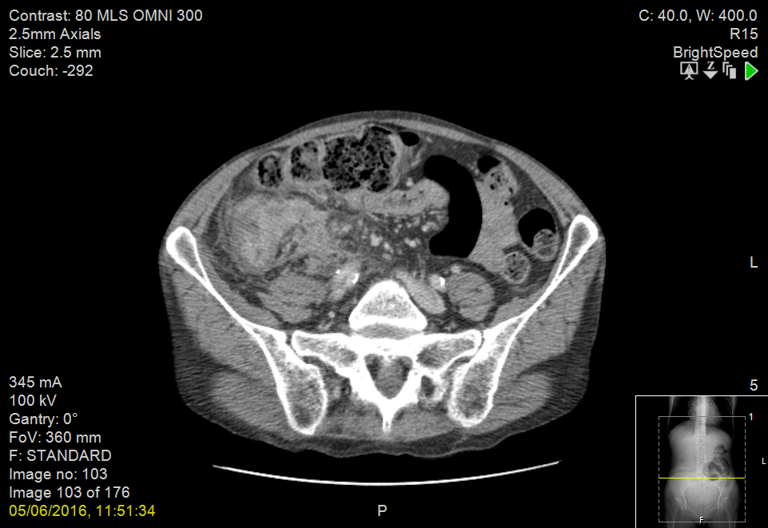
T4 PERITONEAL DISEASE

Slide 3
Zones
Cardiophrenic
Subdiaphragmatic
Subcapsular
Morrisons pouch
Omentum
Mesentery
Pelvic

Slide 4
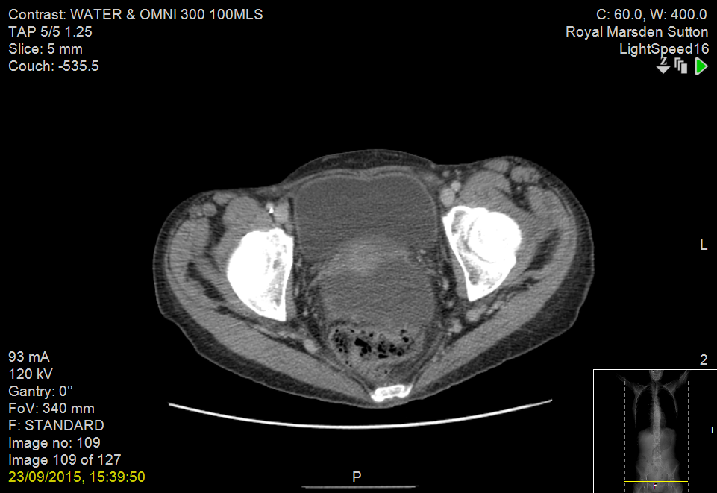

Slide 5
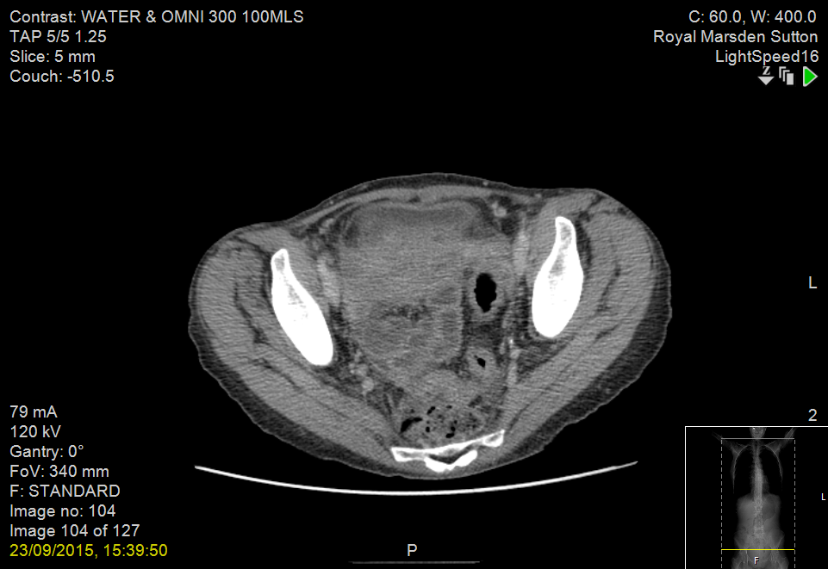

Slide 6
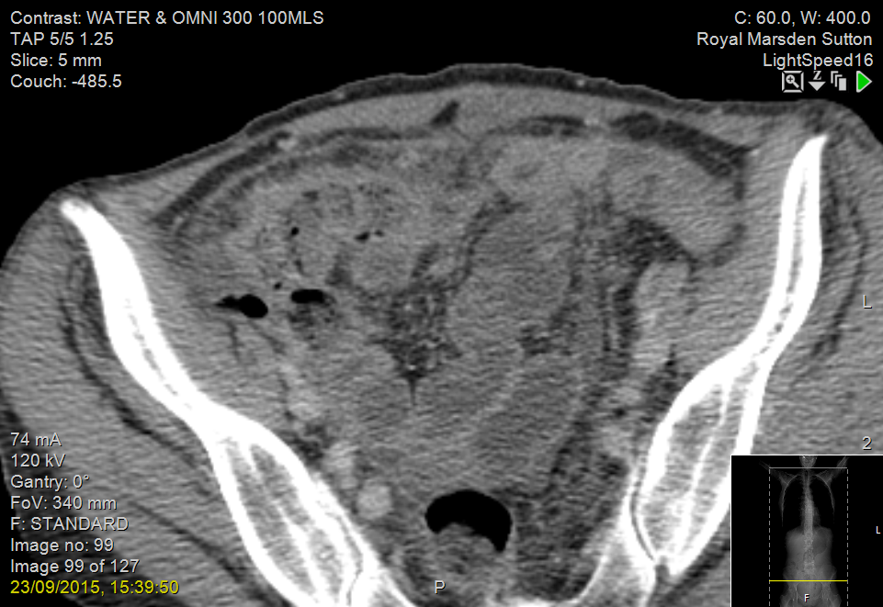

Slide 7
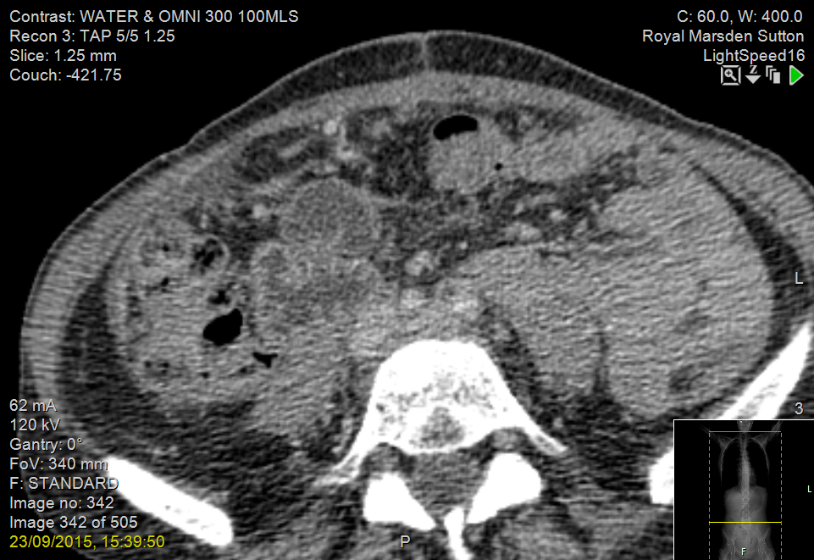

Slide 8
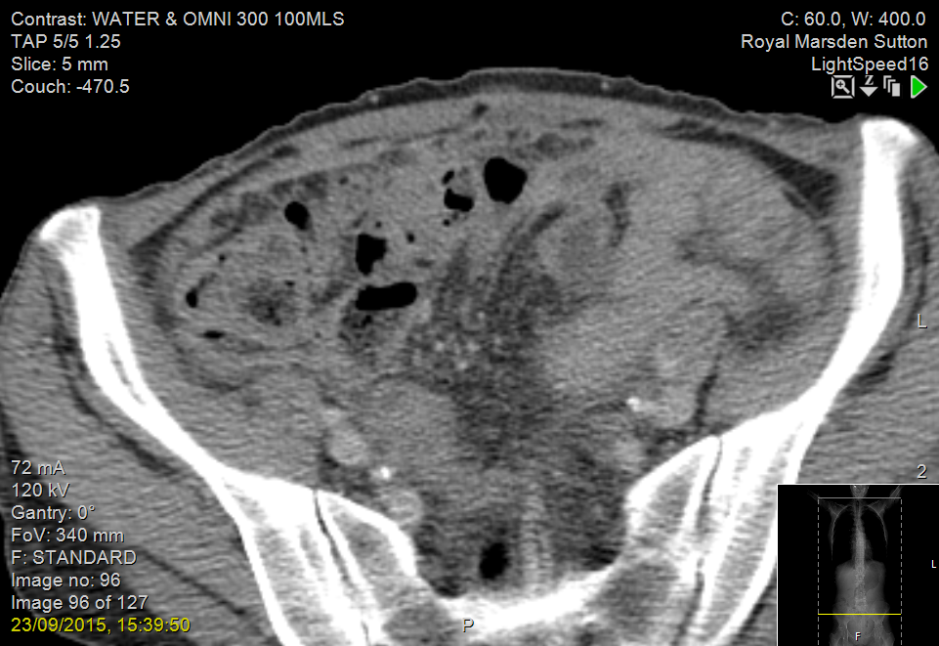

Slide 9
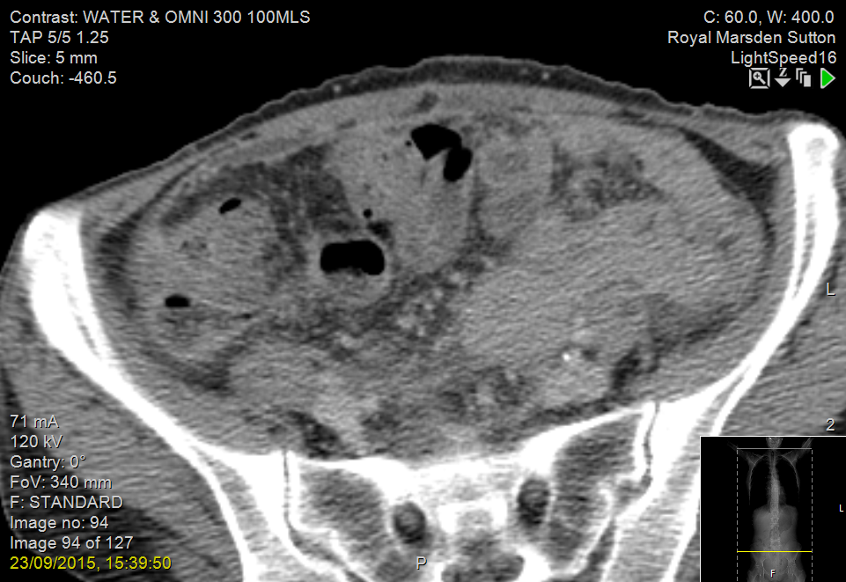

Slide 10
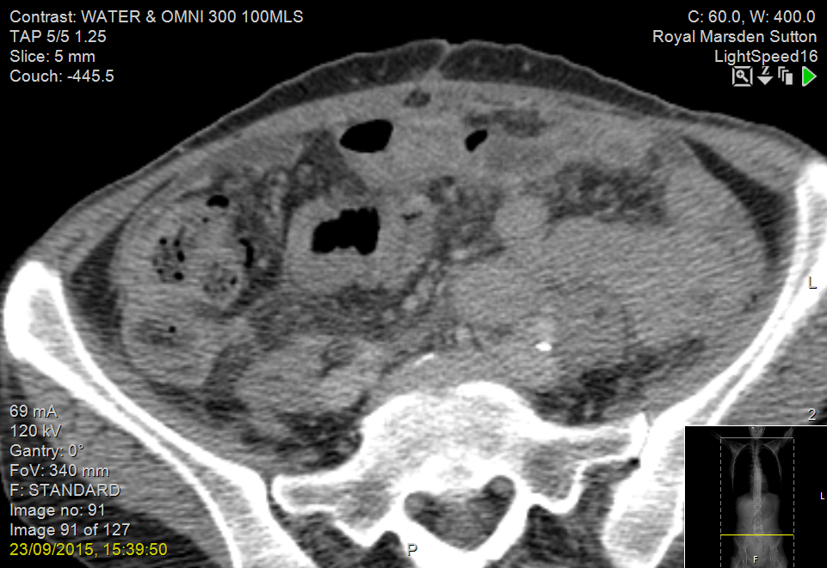

Slide 11
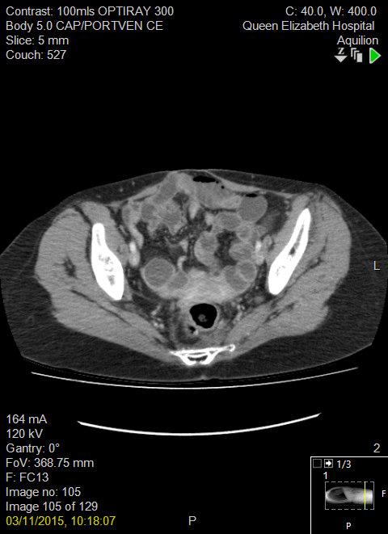
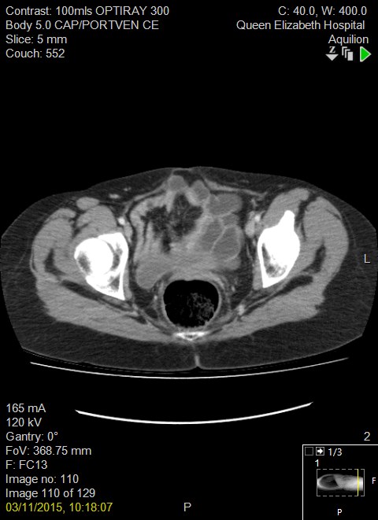
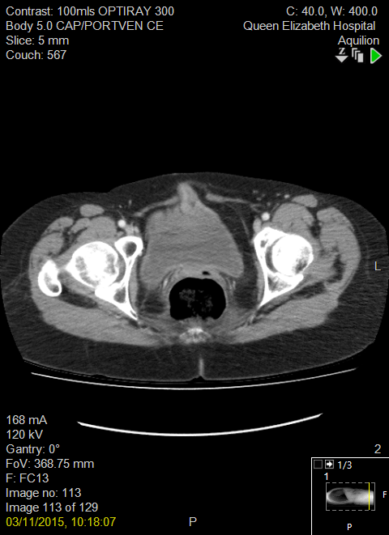
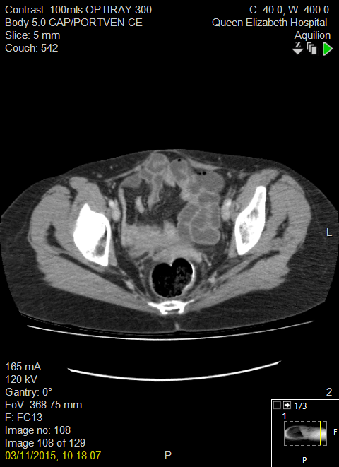

Slide 12
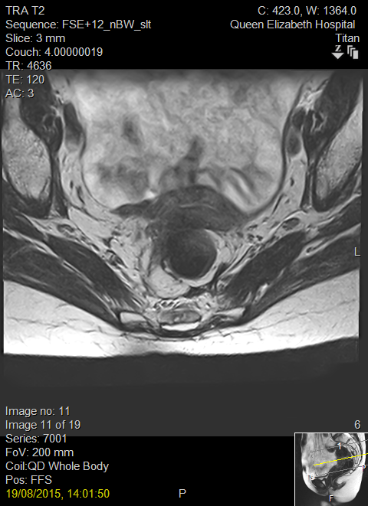

Slide 13
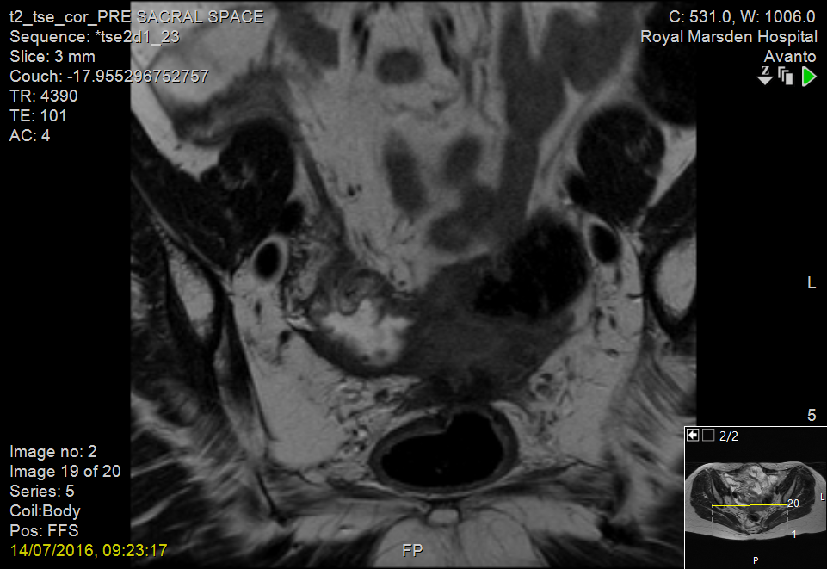

Slide 15
CONCLUSION Recurrent rectal adenocarcinoma involving large bowel wall, extramural tissue, right parovarian tissue and right ovary in specimen B. There is a separate deposit in vaginal tissue in specimen D.

Slide 16
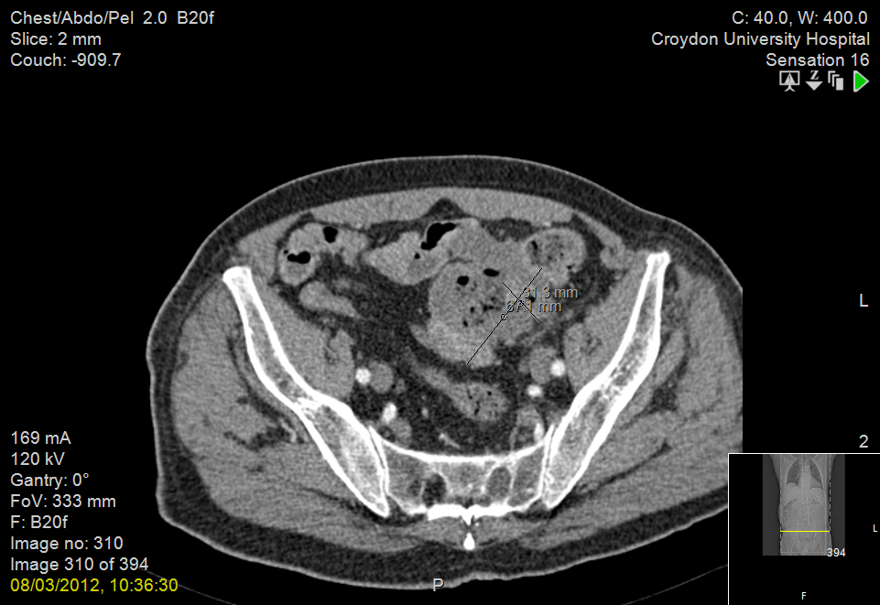

Slide 17
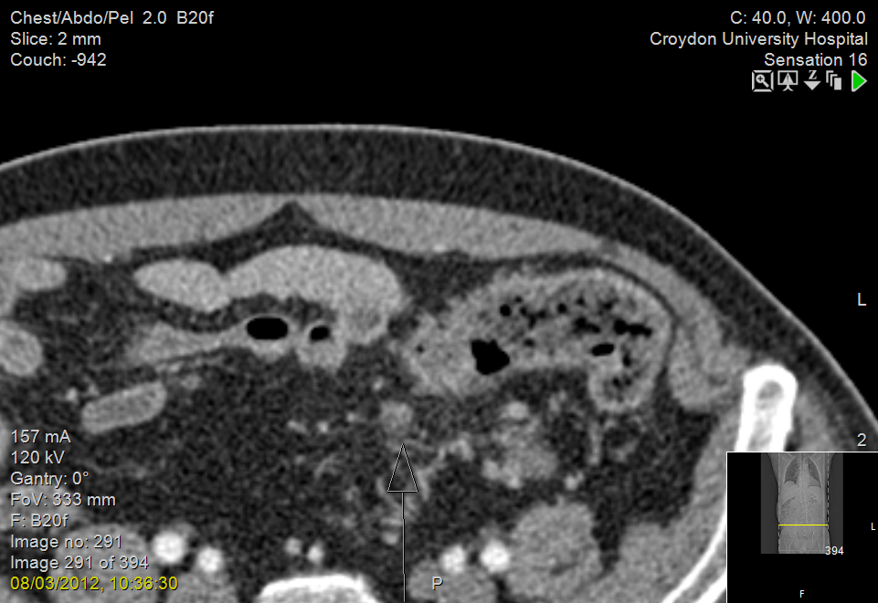

Slide 18
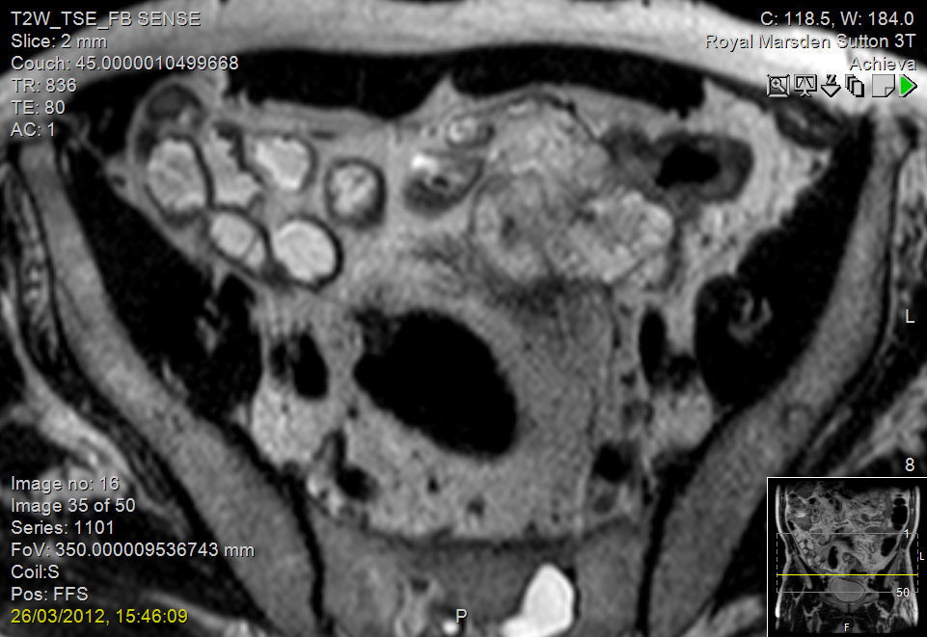

Slide 19
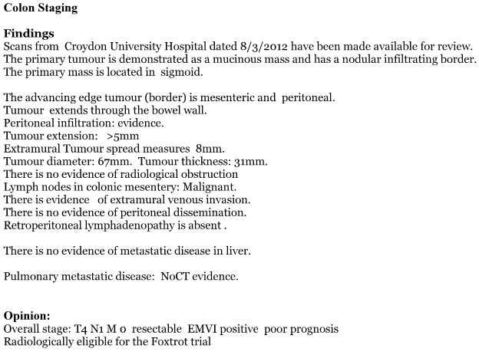
MDT CT report

Slide 21
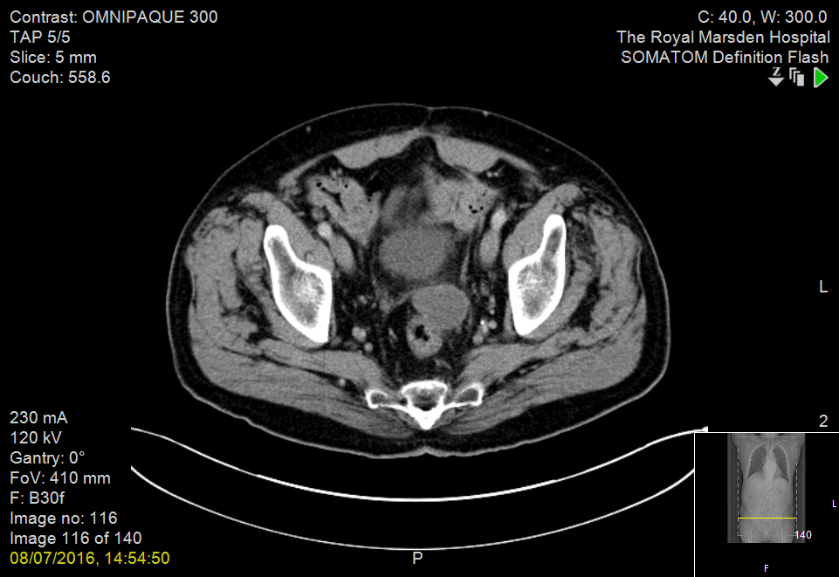
Early signs

Slide 22
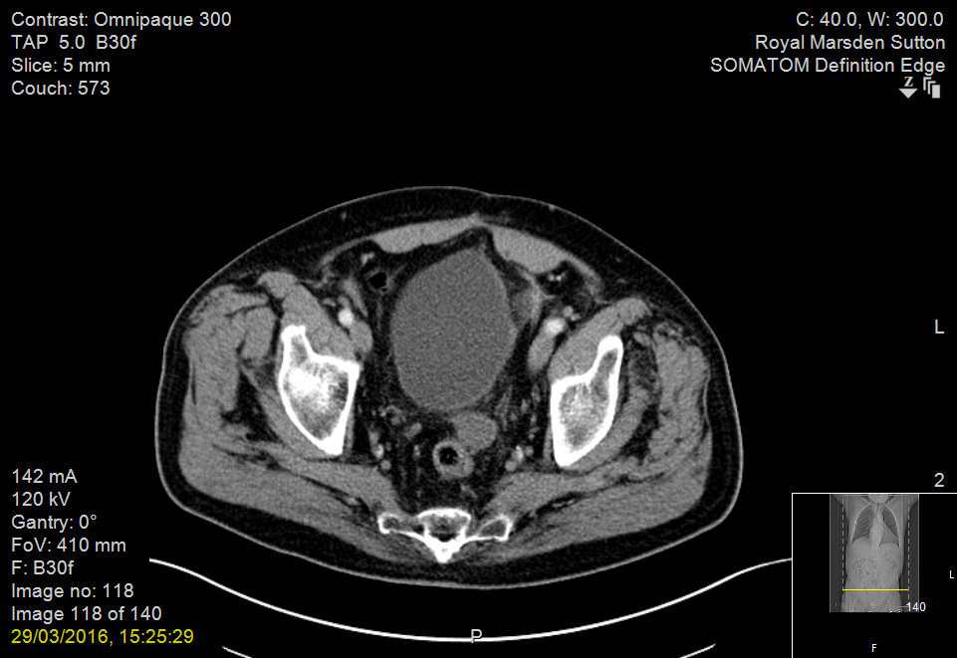
Krukenberg

Slide 23
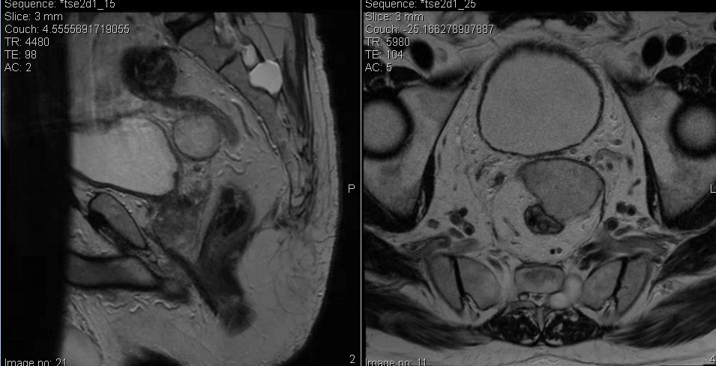

Slide 25
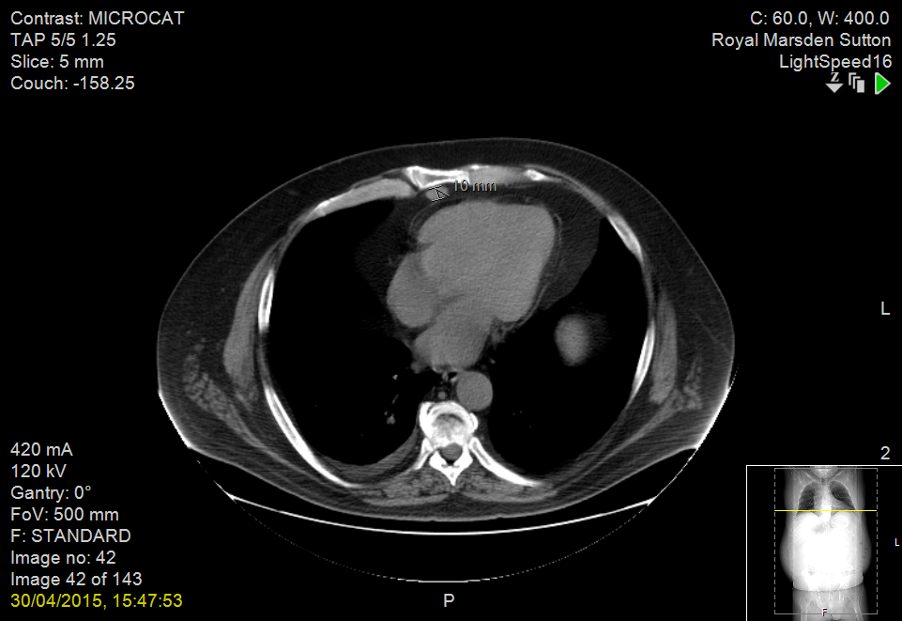

Slide 26
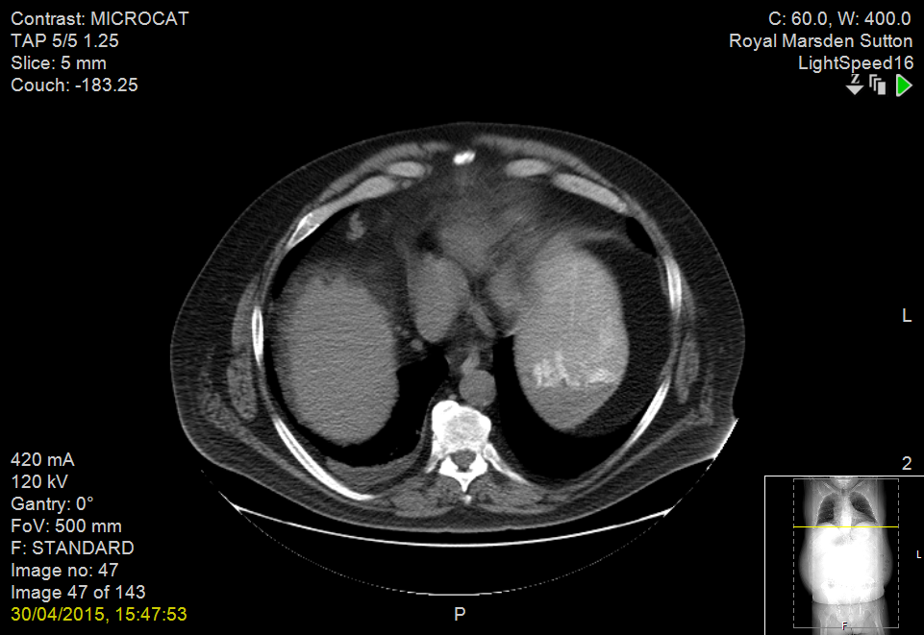

Slide 27
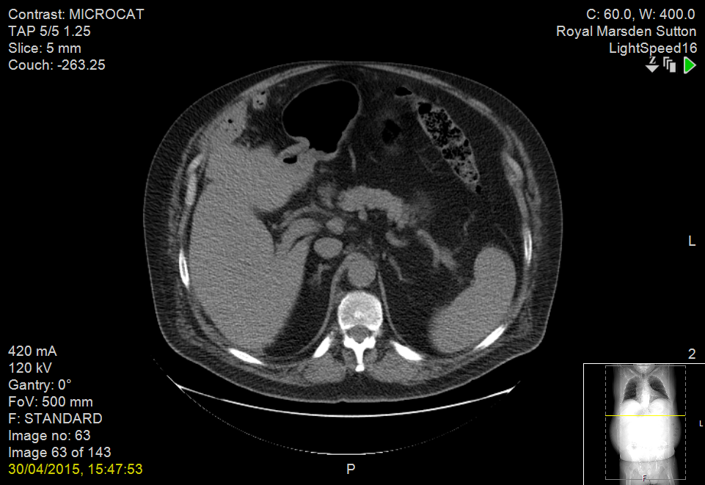

Slide 28
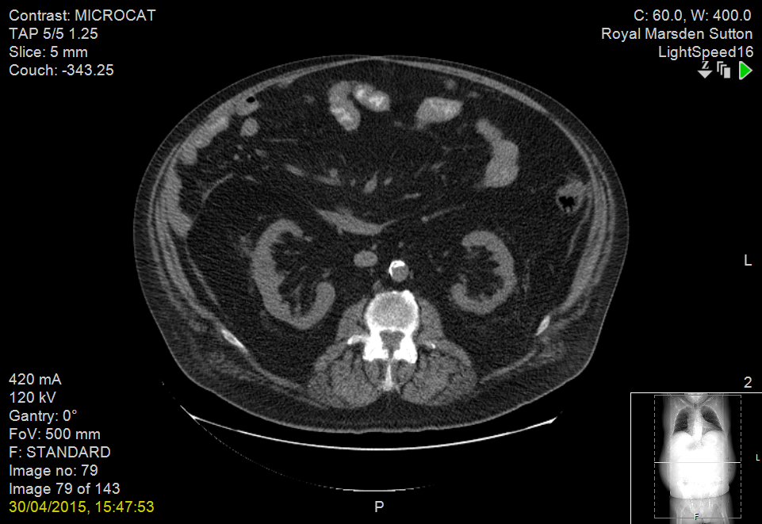

Slide 29
