Slide 1
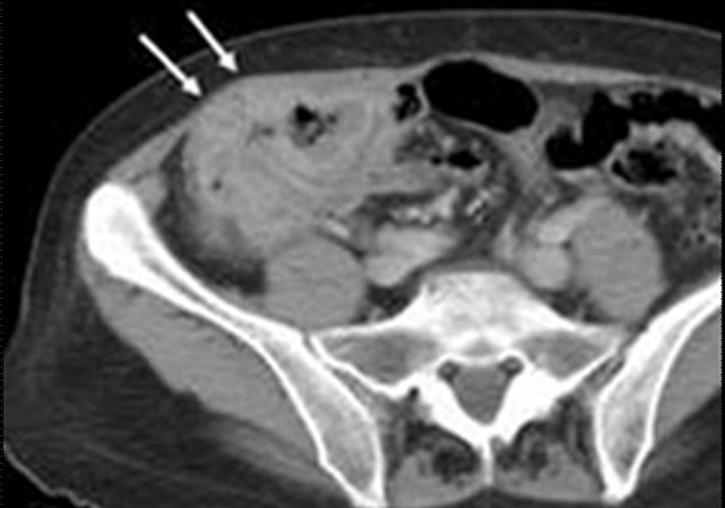
Sigmoid and Colon cancer staging
Gina Brown
Academic Department of Radiology
Royal Marsden Hospital, UK

Slide 2
Staging of colon cancers
Dukes Histological system for rectal cancers extrapolated for colon cancers
5 year survival:
  81% if confined to bowel wall
  64% if invasion through the wall
  27% if local lymph nodes involved
AJCC TNM staging system
  T stage, N stage, M stage
  7th Edition [Edge and Compton, 2010]
Notes:
Therefore only available post operatively
At this stage only use was prognostication, did not inform treatment choice
2

Slide 3
Other prognostic factors
Extramural Vascular Invasion (EMVI)
  Reduced 5 year survival
Depth of extramural spread
  Hermanek divided T3 tumours into 4 groups
Involvement of Non Peritonealised Resection Margin
  Very high risk local recurrence
Histological grade
  Well differentiated, 76% 5 year survival
  Poorly differentiated, 31% 5 year survival
Notes:
Large proportion of tumours are T3, T3a and T3d tumours very different prognosis
NPRM previously called CRM
3

Slide 4
How often are prognostic factors reported preoperatively in colon cancer?
- EMVI
- depth of extramural spread in mm
- non-peritonealised resection margin
- transperitoneal breach?

Slide 5
Currently: no role for imaging for local staging of colon cancers?

Slide 6
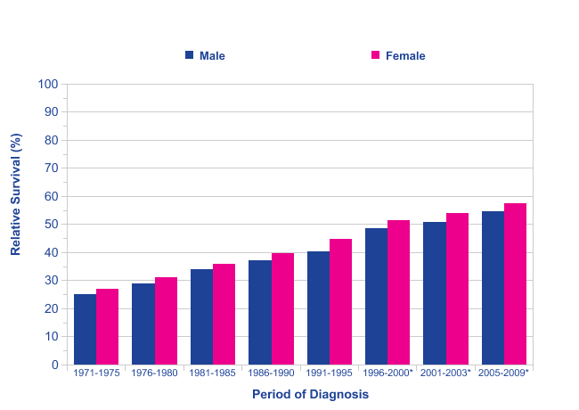
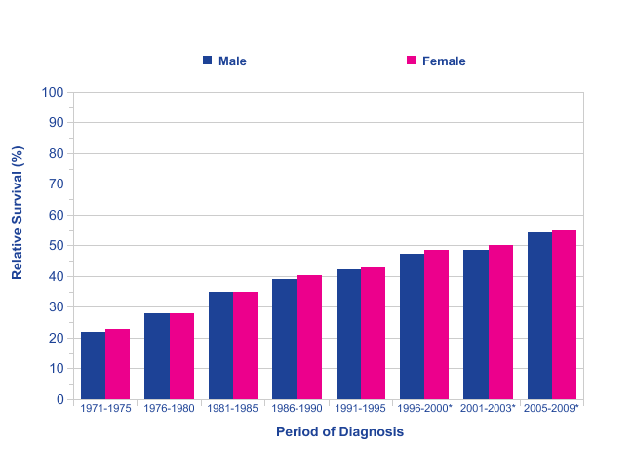
Survival
Rectal Cancer
Age-Standardised Five-Year Relative Survival Rates
England and Wales 1971-1995, England 1996-2009
Colon Cancer
Age-Standardised Five-Year Relative Survival Rates
England and Wales 1971-1995, England 1996-2009
Cancer Research UK
Notes:
Over the past decades there have been impressive changes in our approach of rectal cancer. One of the most important changes concerns the standardization of preoperative staging based on MRI. Preoperative staging means that we are able to identify high risk patients who will benefit from neoadjuvant treatment and an eventually modified surgical approach.
This slide shows the improvement in 5-yrs survival we achieved over the passed 40 years. At the left side, it shows the increase in survival for patients with rectal cancer. At the right side, it shows the increase in survival for patients with colon cancer. However, it also shows how rectal cancer has surpassed colon cancer in this regard. It appears that patients with colon cancer nowadays have a worse prognosis than patients with rectal cancer.
How did this happen? Did we neglect colon cancer?
Birgisson H, Talback M, Gunnarsson U, Pahlman L, Glimelius B. Improved survival in cancer of the colon and rectum in Sweden. Eur J Surg Oncol 2005; 31:845–53.

Slide 7
Treatment options for
Colon Cancer
Treatment options for
Rectal Cancer
Palliative Chemotherapy
Metastatectomy
EMS /TEMS
pre/post operative CRT
MRI surveillance…
MRI T1/T2 Nx
Local excision
CT Staging
Metastatic
disease?
Yes/No
MRI based
Selection
of patients
For range
treatments
MRI T3a/T3b N any
Low rectal stage 1/2
Primary TME Surgery: open v laparoscopic
10-20%
MRI T3c/T3d N any
EMVI positive CRM safe
Biological agents and neoadjuvant
chemotherapy for MRI EMVI
80-90%
Chemoradiotherapy
Restage:
Timing of
surgery
after CRT
6 vs 12?
Further Therapy
/Extended surgery
for mrCRM/low rectal
potential CRM unsafe
Primary colon resection:
laparoscopic/open
MRI Low rectal
Stage 3 or 4
Post CRT
yMRI TRG 1-2
MRI and PET surveillance
Deferral of surgery
Notes:
The treatment options for rectal cancer are summarized here and are numerous.
As soon as we measure a tumour just 1 cm proximal from the rectum, we call it sigmoid cancer and our approach changes dramatically. The options for patients with colon and sigmoid cancer seem to be reduced to only 2 options: …

Slide 8
Colon Cancer has a high recurrence rate.
O’Connell 2008 ACCENT Data Set
n=17,381
recurrence= 5,722 (32%)
J Clin Oncol. 2008 May 10;26(14):2336-41.
Notes:
Colon cancer has a high overall recurrence rate of more than 30%.
O’Connell 2008
Survival following recurrence in stage II and III colon cancer: Findings from the ACCENT Data Set
ACCENT = stage II/III colonca from diff prosp rand trials of postop FU-based CTx
N=17,381, FU 8yrs
recurrence 5,722 (32,9%)
Recurrence: 20% stage II, 80% stage III
Median time recurrence 13.3 months
Of these 84% had CTX after surgery
TrialAccrual PeriodTreatment Arm(s)No. of PatientsEra I 1978-1985 NSABP C011977-1983Control v MOF 724 NCCTG 7848521978-1984Control v FU/LEV 247 FFCD1982-1990Control v FU/LV 256 NSABP C021984-1988Control v PVI FU 896 INT 00351984-1987Control v FU/LEV 926 Siena1985-1990Control v FU/LV 239Era II 1986-1992 NCIC1987-1992Control v FU/LV 359 NSABP C031987-1989MOF v FU/LV 1,042 NCCTG 8746511988-1989Control v FU/LV 408 GIVIO1989-1992Control v FU/LV 867 NCCTG 8946511989-1991FU/LV ± LEV for 6 or 12 months915 NSABP C041989-1990FU/LEV v FU/LV v FU/LV/LEV 2,083 INT 00891990-1992FU/LEV v 5FU/LV (HD or LD) v FU/LV/LEV 3,561 NSABP C051991-1994FU/LV v FU/LV+ IFN 2,136Era III 1993-1999 NCCTG 9146531993-1998FU/LV + HD or standard LEV878 SWOG 94151994-1999Bolus v infusional FU/LEV/LV 939 GERCOR C96.11996-1999Bolus v infusional FU/LV 905Total17,381

Slide 9
Metaanalysis

Slide 11
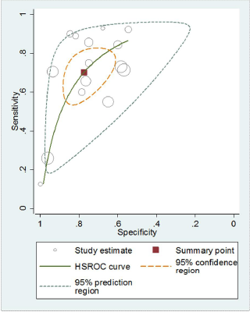
Nodal Staging

Slide 12
Meta-analysis conducted on studies assessing accuracy of CT in staging colorectal cancer to detect tumour invasion beyond MP :
  Sensitivity is as high as 86%.
  Specificity of 78%
The ability of CT to predict the nodal status is however poor.
However none of the studies ever looked at the ability of CT to predict prognosis.
Dighe S, Purkayastha S, Swift I, Tekkis PP, Darzi A, A'Hern R, Brown G: Diagnostic precision of CT in local staging of colon cancers: A Meta analysis. Clin Radiol. 2010 Sep;65(9):708-19.
Notes:
12

Slide 13
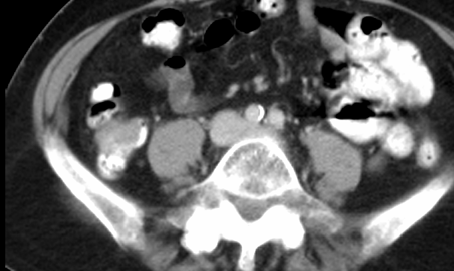
Good prognosis T2/early T3

Slide 14
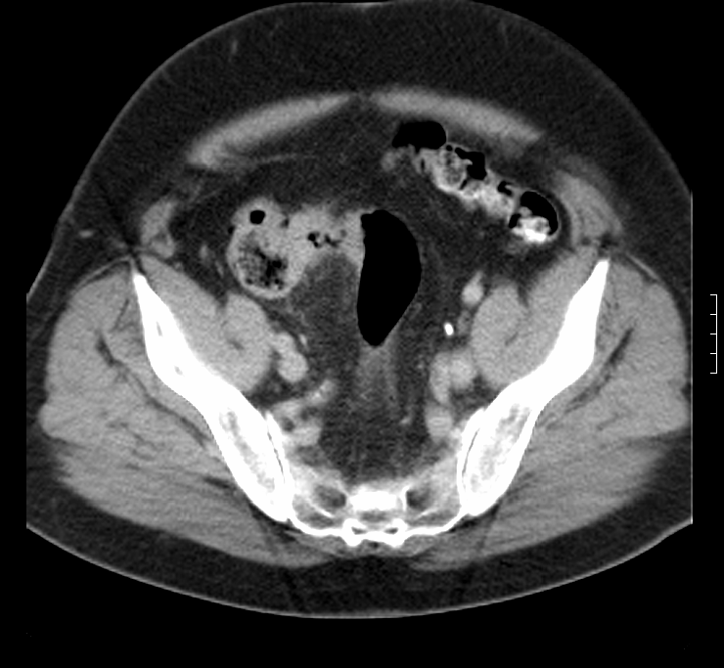
T3 good tumour

Slide 15
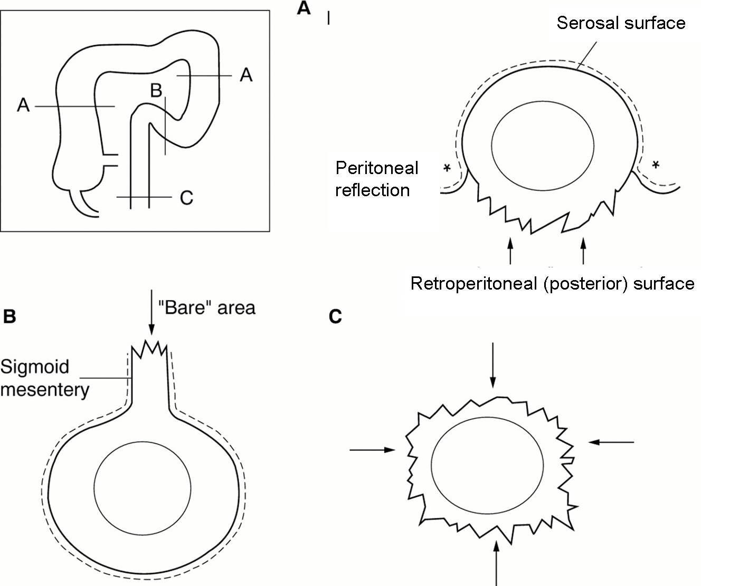
Understanding T4 disease

Slide 16
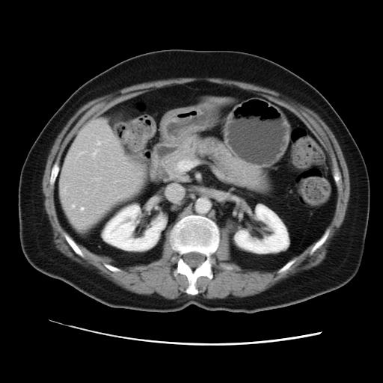

Slide 17
Poor prognosis

Slide 18
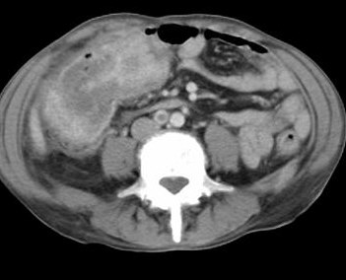
*

Slide 19
Poor prognosis

Slide 20
CT staging of colons
To examine whether the radiological features of the primary colonic tumour seen on the pre-operative CT scan could be used to predict clinical outcome.
To compare pre-operative CT-based prognostication with post-operative histology
Smith N, Bees, N. Predicting Prognosis in Colon Cancer: Validation of a New Preoperative CT Staging Classification and Implications for Clinical Trials. Colorectal Disease 2006; 8

Slide 21
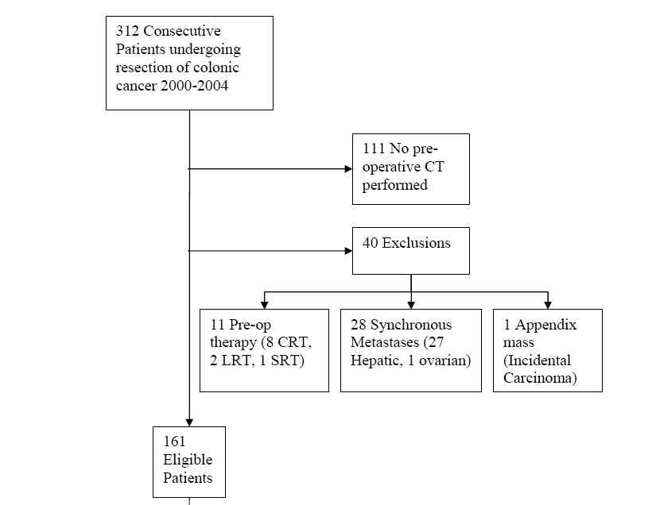
126 scans analysed

Slide 22
Prognostic score
Histological variable | Good prognosis | Poor prognosis
T stage | T1, T2 or T3<5mm | T3>5mm or T4
N stage | N0, N1 | N2
EMVI | Absent | Present

Slide 23
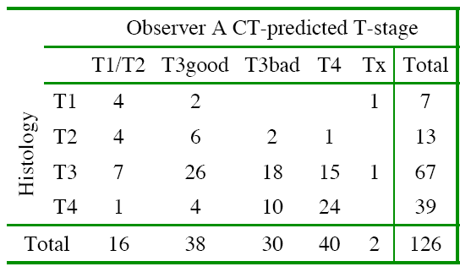
Identification of poor prognosis tumours
56% (70/126) had CT defined poor prognosis tumours

Slide 24
T staging / prognosis
Stage-for-stage accuracy=60.3%
Poor prognosis (Stage T3/T4, N2, EMVI)
  Overall Accuracy=83.3% (Sensitivity=92.4%; Specificity=42.1%)
  Positive Predictive Value=89.8%; Negative Predictive Value=50.0%

Slide 26
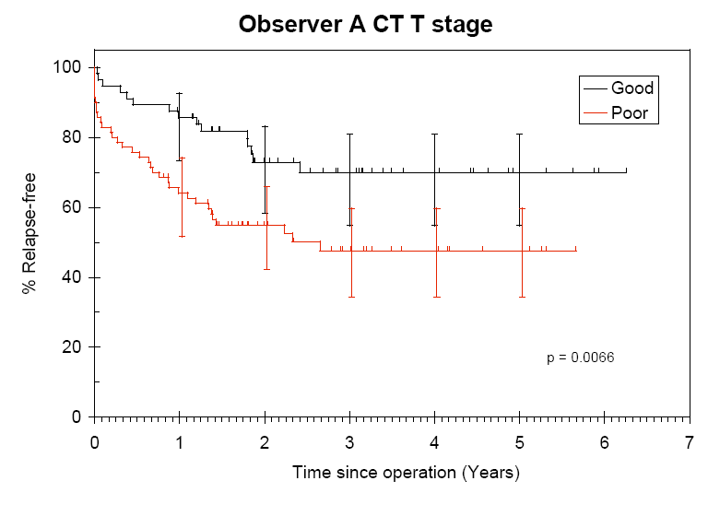
CT prediction of prognosis

Slide 27
the depth of tumour invasion beyond the muscularis propria (MP) as seen on CT and demonstrated excellent correlation with histology.
  T1/T2 + T3 <5mm tumour invasion beyond MP (87% 3-year survival).
  T4+T3≥5mm tumour invasion beyond MP (53% 3 year survival).
Smith N, Bees, N. Predicting Prognosis in Colon Cancer: Validation of a New Preoperative CT Staging Classification and Implications for Clinical Trials. Colorectal Disease 2006; 8
Notes:
27

Slide 28
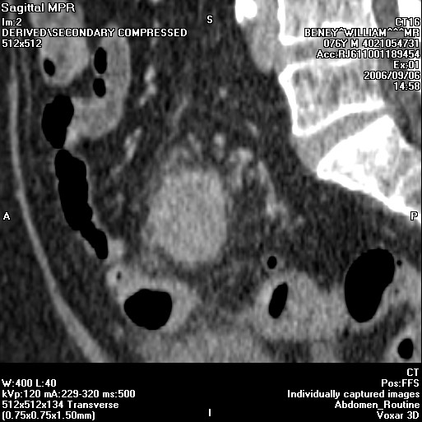
Can we refine the radiological definition of poor prognosis?
Involvement of peritoneal surfaces

Slide 29
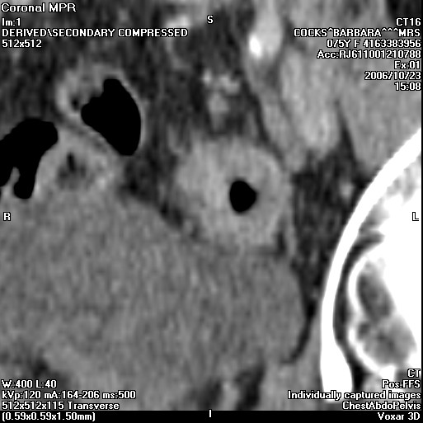
Can we refine the radiological definition of poor prognosis?
Dighe S, Blake H, Koh MD, Swift I, Arnaout A, Temple L, Barbachano Y, Brown G: Accuracy of multidetector computed tomography in identifying poor prognostic factors in colonic cancer. Br J Surg. 2010 Sep;97(9):1407-15.
Sensitivity: 78%
Specificity: 67%
Accuracy: 74%
PPV: 81%

Slide 30
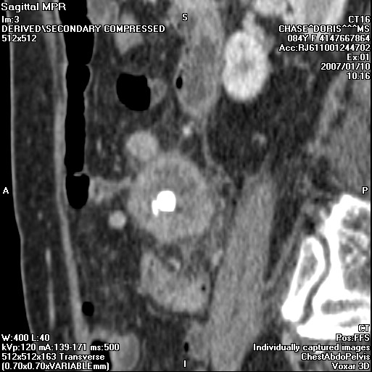
Can we refine the radiological definition of poor prognosis?
  Involvement of the peritoneal and mesenteric surfaces
  Lymph node involvement
    Sensitivity 58%
    Specificity 64%

Slide 31
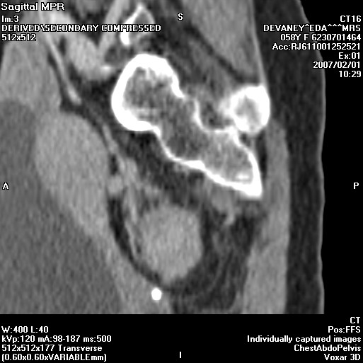
Can we refine the radiological definition of poor prognosis?
Data collection
  Involvement of the peritoneal and mesenteric surfaces
  Lymph node involvement
  Extramural venous invasion

Slide 32
Detection of EMVI using MDCT: high positive predictive value

Slide 33
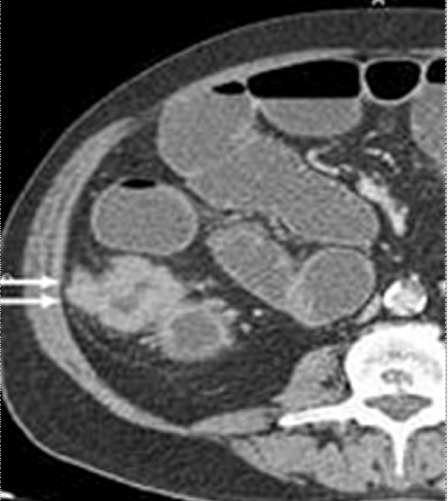
Value of >5mm Extramural Depth of Spread using CT
77 % of patients (42 of 54)with a histologically poor prognosis were identified based on T category
also 74 % of node-positive patients (29 of 39) compared with 58% by using size

Slide 34

FOxTROT trial design
CT staging
T3+ or N2+ colon cancer,
potentially curative
3 Fu Ox
± Pan
(6 weeks)
S
u
r
g
9 Fu Ox
(18 weeks)
R
a
n
d
o
m
is
e
n=700
n=350
S
u
r
g
12 Fu Ox (24 weeks)
± Panitumumab (6 weeks)
Primary outcome – freedom from disease at 2 years

Slide 35
End points of Foxtrot trial
1050 patients over 3 years (150 pilot + 900)
  for recurrence free survival; 80% power at p<0.05 to detect 25% proportional reduction in treatment failure, e.g. Recurrence reduced from 32% to 24%.
  for tumour shrinkage; 90% power at p<0.01 to detect a small/moderate (0.3sd) difference in pathological tumour shrinkage with addition of panitumumab, i.e. Depth of invasion.

Slide 36
Imaging– what’s new in this trial?
  New staging system
  Knowledge and visualisation of peritoneal anatomy
  Identification of poor prognostic features in vivo
  Quality assurance: workshops, detailed imaging data collection

Slide 37
This trial is thus reliant on the ability of the radiologists to identify a cohort of high risk patients suitable for randomisation to receive neoadjuvant therapy.
Notes:
37

Slide 38
Summary colon cancer staging
Tumour morphology: annular, semi-annular, mucinous, ulcerating
Site : caecum, ascending, hep flexure, transverse, splenic flexure, descending, sigmoid
Border of infiltration: mesenteric vs peritonealised
Diameter and thickness
T substage (good or poor): T3<5mm or >5mm
Nodal and venous spread: ileocolic, middle colic, left colic, sigmoidal veins
Adjacent organ infiltration/perforation/obstruction
Synchronous metastatic disease

Slide 39
Was CT successful in identifying high risk? Control arm pathology
49/50 – pT3/4 (98%)
2643/50 – AJCC pTNM stage II/III high risk (86%)
/50 –pNode positive (52%)
10/50 – 20% pCRM positive
24/48 – (50%) pEMVI positive

Slide 40
Sigmoid Cancer is a problem
Dis Colon Rectum. 2010 Jan;53(1):57-64.
Notes:
Amongst colon cancer, the sigmoid is the most affected. About 40% of all colon cancers are found in the sigmoid. But what do we know about sigmoid cancer? Do we know why the outcome of colon including sigmoid cancer is lagging behind rectal cancer nowadays?

Slide 41
Recurrence sigmoid cancer
 |  | N= | Follow-up | Local recurrence colon | Local recurrence sigmoid
Cass 1976 | Retrospective 1968-1974 | 280 | Min 1 yr | 22,5% | 25%
Willett 1984 | Retrospective | 533 |  | 19% | 21%
Sjövall 2007 | Prospective 1996-2000 | 1,856 | Min 3 yrs | 11,5% | 11,6%
Notes:
A search shows that there is hardly any literature about recurrence rate and recurrence pattern of sigmoid cancer.
Sjovall: Swedish National Cancer Registry (FU colon ca since 1996)

Slide 42
Recurrence sigmoid cancer
MDT 2007-09
296 sigmoid cancers
104 for palliative care
Curable sigmoid cancers: n=192
No FU data at all: n=42
With FU: n=150
FU 36 months (range 1-76, median 38)
Recurrence: 62/192 (32%)
Local recurrence: 19 (11%)
Notes:
We performed a study of our own data on sigmoid cancer. All patients with sigmoid cancer who had been discussed during the Multidisciplinary Meeting were included.
….
Recurrences:
Local 9
Peritoneal/omentum/abd wall 12
Retroper nodes 3
Distant 38
T1/2N0: 23
T1/2N+: 0
T3/4N0: 1
T3/4N+: 36
Unknown : 2

Slide 43
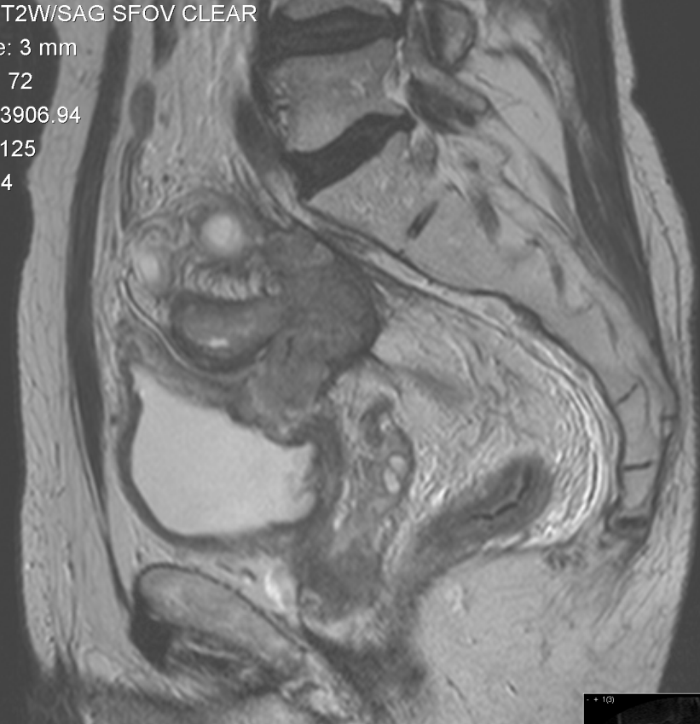
High risk features
  Tumour involving non peritonealised fascial margin
  Tumour penetration of adjacent organs
  4 or more involved nodes
  Extramural venous invasion
  Depth of extramural spread >5mm
Notes:
To minimize the risk of local recurrence, preoperative planning is crucial. Preoperative imaging is the key to an optimal patient tailored treatment plan. With preoperative imaging we are able to distinguish between good and poor prognostic tumours.
We know which tumour features impose a poor prognosis in colon cancer – they are similar to rectal cancer.

Slide 44
Burton 2006 Int. J. Radiation Oncology Biol. Phys
Notes:
In a study by Burton in 2006 it was demonstrated that MRI can identify poor prognosis features in sigmoid cancer.
Chemoradiotherapy – for any patient with disease extending to or beyond a non-peritonealised resection margin: ie posterior retroperitoneal and lateral sidewall fascia or adjacent organ invasion
Remainder: Primary surgery including N2, EMVI and tumour spread >5mm but non-peritonealised resection margin safe

Slide 45
Primary surgery
n=57
16 at/above peritoneal reflection
19 rectosigmoid
22 sigmoid
Neoadj CRTx + surgery
n=18
9 at/above peritoneal reflection
5 rectosigmoid
4 sigmoid
Burton 2006 Int. J. Radiation Oncology Biol. Phys
Notes:
A total of 75 patients with distal sigmoid, rectosigmoid, and upper rectal tumors were assessed preoperatively by MRI. If tumor extended beyond the planned surgical resection plane, chemoradiotherapy
was offered.
distal sigmoid, rectosigmoid, and upper rectal tumors (>10cm)
Good: T1-T2, T3 5 mm, N0-N1, no EMV, potentially CRM negative > Primary surgery
Bad: T3 5 mm, T4, N2, EMV present, potentially CRM negative > Primary surgery
Bad: T4 invading adjacent organs and/or potentially CRM positive > Preoperative chemoradiotherapy

Slide 46
MRI predicted prognosis with final histological prognosis in 57 patients undergoing primary surgery
84% (CI =72.6-92.7%) accuracy for MRI prediction of prognosis
Kappa = 0.63
Sensitivity = 90%
Specificity = 72%
Positive predictive value = 88%
Negative predictive value = 76%
Burton 2006 Int. J. Radiation Oncology Biol. Phys

Slide 47
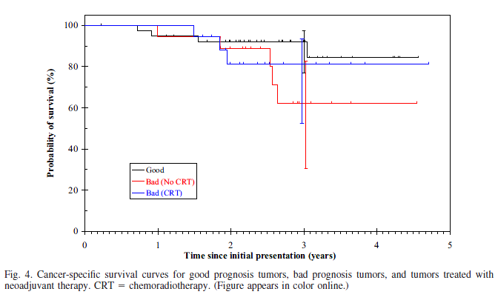
Neoadjuvant Treatment
Burton 2006 Int. J. Radiation Oncology Biol. Phys
Notes:
Burton showed that tumors of the distal sigmoid, rectosigmoid, and upper rectum can be staged accurately using high spatial resolution MRI and that those with poor prognostic disease may benefit from preoperative therapy.

Slide 48
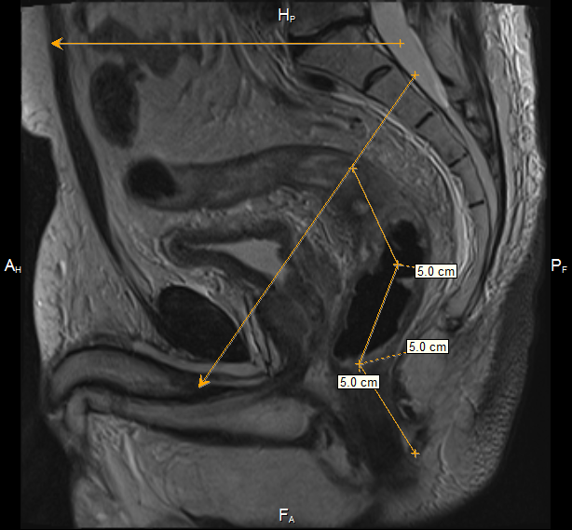
Pelvic sigmoid
Notes:
We will limit our inclusion to pelvic sigmoid tumours, for the following reasons. First of all, MRI artefacts will be less due to the fact that the pelvic sigmoid is still relatively fixed compared to more proximal parts. Secondly, in case of high risk tumours neoadjuvant treatment will be more accepted as a treatment option by MDT’s in pelvic tumours than in more proximal ones.

Slide 49
Staging and treatment
Sigmoid colon has traditionally been grouped with the remainder of the colon
  Direct continuation of the rectum located in the pelvis treating sigmoid cancer
  Subject to the same constraints as rectal cancer with similar potential surgical challenges and risks of a threatened margin
Improved image quality in rectal has enabled better tumour depiction and superior risk stratification
Precise imaging staging enables appropriate surgical and oncological treatment planning
This could translate into a reduction in pelvic recurrence rates

Slide 50
Preoperative staging
Currently CT is widely used to assess sigmoid cancers,
CT has limited ability to delineate pelvic structures and detailed anatomy
High resolution MRI better suited evaluating pelvic structures
May help to identify those at risk of incomplete resection/ local recurrence
Such patients may benefit from radical neoadjuvant treatment and more accurate surgical ‘road-mapping’

Slide 51
IMPRESS Trial
Hypothesis:
Accurate preoperative imaging (MRI) will improve recurrence rate and survival through:
  better surgical decision making
  Greater proportion receiving radical treatment (neoadjuvant therapy or extended surgery)

Slide 52
Biopsy proven sigmoid cancer
OBSERVATIONAL PATHWAY
MRI is local policy
INTERVENTIONAL PATHWAY
Randomised to have MRI
Randomised not to have MRI
MDT review CT & MRI
MDT review CT & MRI
MDT review CT only
Treatment Outcomes

Slide 53
Endpoints IMPRESS Trial
Primary:
  Observational: Measure difference in detection of high risk patients between CT and MRI and the resultant difference in Rx strategy
  Randomised: Compare the proportion of patients undergoing radical treatment in the two arms
Secondary:
  Recurrence rate at 1, 3 and 5 years
  OS and DFS at 1, 3 and 5 years
  Accuracy of CT and MRI to identify poor prognosis tumours compared to the gold standard of histopathology
  Quality of surgery
  CRM positivity rates on pathology
  Permanent defunctioning stoma rates

Slide 54
Study design
Observational and randomised arms (1:1)
Expected improvement of 20% in sensitivity of detection of high risk patients, 97 patients need to be randomised to each arm
Drop out rate 20%
243 patients needed in randomisation arm
Folllow-up 5 years,
  outcomes reported at 1, 3, and 5 years

Slide 55
Biopsy proven sigmoid cancer
OBSERVATIONAL PATHWAY
MRI is local policy
INTERVENTIONAL PATHWAY
Randomised to have MRI
Randomised not to have MRI
MDT review CT & MRI
MDT review CT & MRI
MDT review CT only
Treatment Outcomes

Slide 56
Sites
Open:
RMH
Croydon
Salisbury
Harrogate
St Mark’s
Opening:
Portsmouth
Taunton
Yeovil
Macclesfield
Scunthorpe
Manchester Royal Infirmary
Hinchingbrooke
East Kent
Leigton
North Tees
Royal Free

Slide 57
IMPRESS Trial
IMProving Radical treatment through MRI Evaluation of pelvic Sigmoid cancerS
Contact
  Gina Brown (Principal Investigator)
  Gina.Brown@rmh.nhs.uk
  Lisa Scerri (Clinical Trial Coordinator)
  lisa.scerri@rmh.nhs.uk 0208 915 6067

Slide 58
Sigmoid cancer
Sigmoid cancer has a high recurrence rate
Sigmoid cancer has a worse outcome than rectal cancer
MRI is able to identify poor prognostic tumours preoperatively
Preoperative staging enhances optimal treatment strategy including neoadjuvant treatment
Sigmoid cancer with poor prognostic features should be discussed for neoadjuvant treatment (IMPRESS Trial)

Slide 59
Better staging Colon cancer: new treatment possibilities
MRI T1/T2/early T3
Primary Surgery: laparoscopic
MRI based
Selection
of patients
For range
treatments
Biological agents and neoadjuvant
chemotherapy for MRI EMVI
MRI T3c/T3d N any
EMVI positive
CRM safe
MRI and PET surveillance
Screen for metastatic disease
MRI potential resection
margin
unsafe in rectosigmoid
Chemoradiotherapy
Restage:
Further Therapy
/Extended surgery
MRI potential resection
margin
unsafe in colon
Extended surgery

Slide 60
Acknowledgements
Shwetal Dighe, Sarah Burton and Neil Smith, Chris Hunter, Ian Swift and Muti Abulafi and the Royal Marsden Hospital Colorectal Multidisciplinary Network
FoxTrot trial co-investigators: D Morton, P Quirke, M Seymour, R Gray, L Magill.

